Slide 1


CryptoTrack Pro
Presented By
1. Prerana Merukar
2. Pranav Sabale
3. Rucha Chobe
4. Dibyasa Khandai
5. Mehtab Shaikh

Slide 2

Challenges in Crypto Management
Key Pain Points Faced
Managing assets across multiple exchanges
Exposure to scams and rug-pulls
Lack of real-time risk alerts
Complexity in P&L and tax calculations

Slide 3
Proposed Solution
Key Features
Unified portfolio dashboard for exchanges
Automated live price tracking
Integrated scam and risk detection
Tax-ready, comprehensive reports

Slide 4




Key Features of CryptoTrack Pro
Multi-exchange
Risk Alerts
Live Pricing
P&L Summaries
Seamlessly manage assets across various platforms.
Receive immediate notifications about potential threats.
Track real-time market prices effortlessly and accurately.
Generate detailed reports for accurate financial insights.

Slide 5
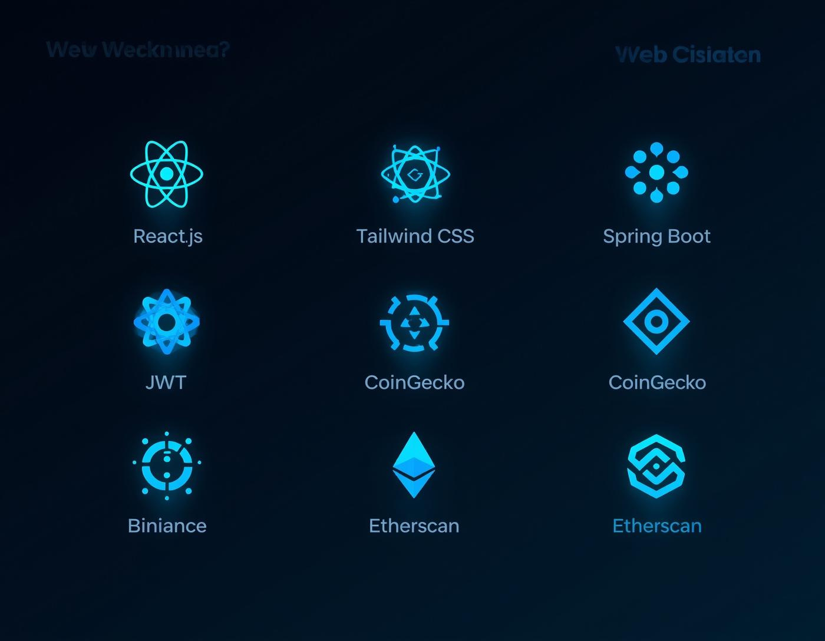
Technology Stack Overview
Innovative Tools for Crypto Development
This stack ensures efficient and secure application performance.

Slide 6
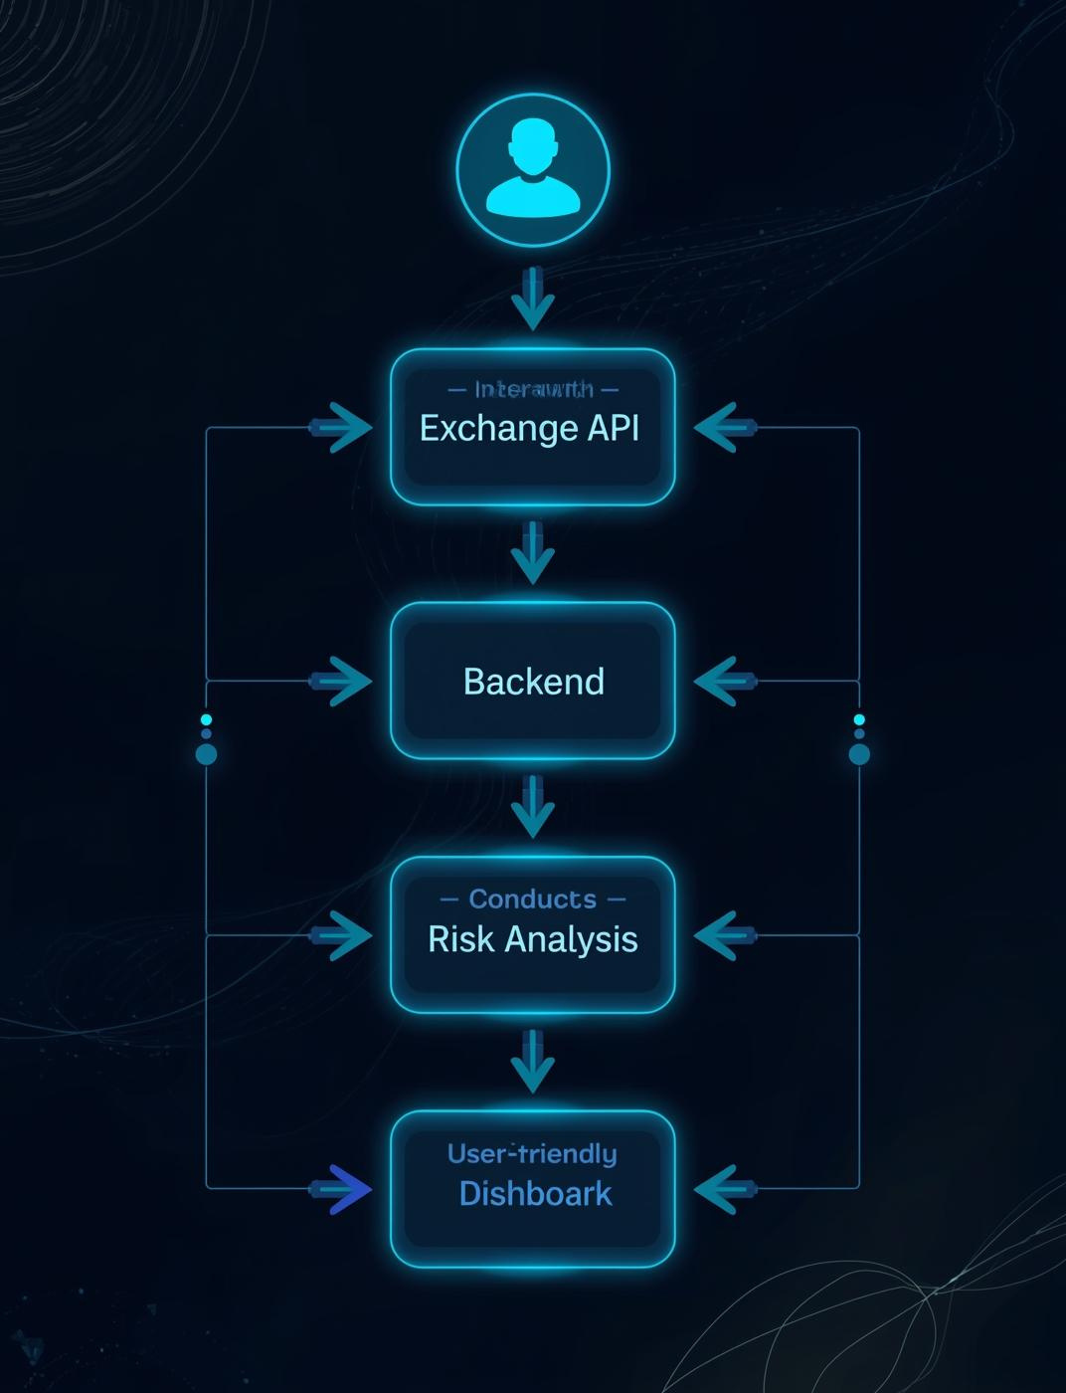
System Workflow
The workflow ensures seamless integration from user inputs through APIs to risk analysis and data visualization.

Slide 7
Measurable Outcomes
Key Benefits of CryptoTrack Pro
Improved portfolio visibility
Reduced exposure to scams
Time-saving automation features
Accurate financial insights

Slide 8
Future Enhancements
Upcoming Features and Innovations
AI-driven risk scoring models
Dedicated mobile application
Tracking for DeFi & NFT assets
Advanced tax compliance features

Slide 9
Conclusion
To conclude, CryptoTrack pro serves as a comprehensive and intelligent solution for modern crypto investors. It effectively simplifies crypto portfolio management by consolidating assets from multiple exchanges into a single, user-friendly dashboard. By integrating real-time price tracking, profit and loss analysis, and tax-ready reports, the platform enables users to gain clear and accurate financial insights.

Slide 10
Thank You

